Slide 1
My original SE Project
My machine
Input
My SE Project
(original)
Output
This is my task.
It means, to move my SE project in some modified form to be able to execute in cloud!
AZURE

Slide 2
How to move it to cloud (draft)
My output can have few output files, but also some more information
Docker Container
My SE Project
(original)
Output
Input
I will save output files to the Azure Blob Storage. In Some container.
My input files can be located somewhere in cloud.
For example, in the Azure Blob Storage
All other information like accuracy, execution time, start time, be creative,.. m will be stored in the able storage as a single record

Slide 3
What do I Need?
Clean up the existing code and make it modular
Create the Storage Account
Create the input container
Create the output container
Create the Storage Queue to receive the massage which will start the experiment
Make the docker image
Create Azure Container Registry
Push the docker image to the registry

Slide 4








The architecture of the solution
Prof. tarts the container in ACI with:
az container create
The image waits for the message to start the experiment.
ExerimentResult
(5)
Result
IFileStorageProvider.UploadExperimentResult
(4)
(6)
ExerimentRequestMessage
IFileStorageProvider.UploadResultFile
Output
start-queue
(3)
IFileStorageProvider.DownloadInputFile
Input
(1)
(2)
I will manually upload all required input files to the container in azure blob storage
I will put my code to the docker image
I will publish the image
to registry

Slide 5
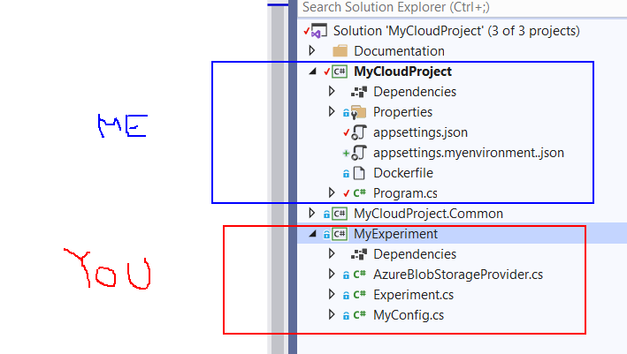
Where do I have to implement my code?
Your implementation is in MyExperiment
MyCloud project is already done (more or less)

Slide 8
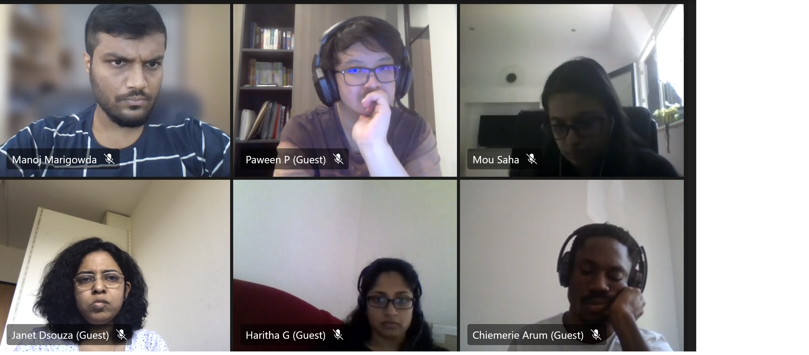

Slide 9
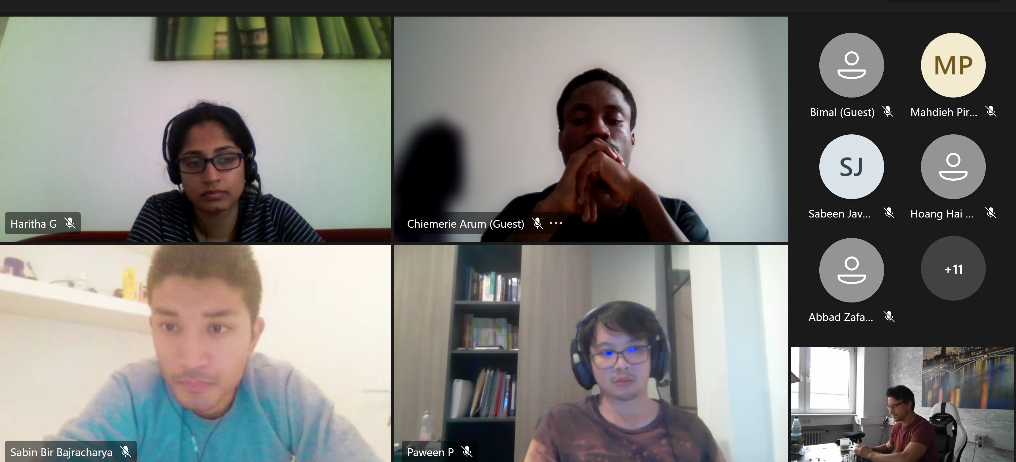

Slide 10
